Slide 1
Chapter 2

Slide 2
2.1 | Introduction to OO Methodologies: Booch, Rambaug and Jacobson
2.2 | Requirements Engineering Tasks, Requirement Elicitation Techniques, Software Requirements: Functional, Non-Functional, Domain Bernd Bruegge Chpater 4
2.3 | Requirements Characteristics, Requirement qualities, Requirement Specification, Requirement Traceability, System Analysis Model Generation, Requirement Prioritization, Documentation: Use Case Diagram, Acitvity Diagram, Bernd Bruegge Chpater 4 & Chpater 2
2.4 | Categorizing classes: entity, boundary and control ,Modeling associations and collections-Class Diagram
2.5 | Dynamic Analysis - Identifying Interaction – Sequence and Collaboration diagrams, State chart diagram

Slide 3
Object Oriented Process
The Object Oriented Methodology of Building Systems takes the objects as the basis.
First the system to be developed is observed and analyzed and the requirements are defined as in any other method of system development.
Objects are identified.
Example: Banking System: customer is an object.

Slide 4
Object Oriented Process
Object Modeling is based on identifying the objects in a system and their interrelationships.
The basic steps of system designing using Object Modeling may be listed as:
System Analysis
System Design
Object Design
Implementation

Slide 5
Advantages Of Object Oriented Methodology
Object Oriented Methodology closely represents the problem domain. Because of this, it is easier to produce and understand designs.
The objects in the system are immune to requirement changes. Therefore, allows changes more easily

Slide 6
Advantages Of Object Oriented Methodology
Object Oriented Methodology designs encourage more re-use. New applications can use the existing modules, thereby reduces the development cost and cycle time.
The systems designed using this approach are closer to the real world as the real world functioning of the system is directly mapped into the system designed using this approach

Slide 7
Class and Object
The concepts of objects and classes are intrinsically linked with each other and form the foundation of object–oriented paradigm.
An object is a real-world element in an object–oriented environment that may have a physical or a conceptual existence.
Object is an entity that has identity , state and behavior.

Slide 8
Class and Object
Objects can be modeled according to the needs of the application. An object may have a physical existence, like a customer, a car, etc.; or an intangible conceptual existence, like a project, a process, etc.
A class represents a collection of objects having same characteristic properties that exhibit common behavior.
Creation of an object as a member of a class is called instantiation. Thus, object is an instance of a class.

Slide 9
THE RAMBAUGH OMT
The object-modeling technique (OMT) is an object modeling language for software modeling and designing.
The object modeling technique(OMT) presented by Jim Rumbaugh and his coworkers describes a method for analysis, design, and implementation of a system using an object –oriented technique.
OMT is a fast and intuitive(easy or simple) approach for identifying and modeling all the objects making up a system.

Slide 10
THE RAMBAUGH OMT
The purposes of modeling according to Rambaugh are:
testing physical entities before building them (simulation),
communication with customers,
visualization (alternative presentation of information), and
reduction of complexity.

Slide 11
THE RAMBAUGH OMT
The Rambaugh OMT has proposed three main types of models:
Object model : Main concepts are classes and associations, with attributes and operations. Aggregation and generalization are predefined relationships.
Dynamic model : The dynamic model represents a state/transition view on the model. Main concepts are states, transitions between states, and events to trigger transitions. Actions can be modeled as occurring within states.

Slide 12
THE RAMBAUGH OMT
Functional model : The functional model handles the process of the model, corresponding roughly to data flow diagrams. Main concepts are process, data store, data flow, and actors.
OMT is a predecessor of the Unified Modeling Language (UML).

Slide 13
THE BOOCH METHODOLOGY
The booch methodology is a widely used object-oriented method that helps you design your system using the object paradigm.
It covers analysis and design phases of an object-oriented system.

Slide 14
THE BOOCH METHODOLOGY
The analysis phase is split into steps:
Customer's Requirements
Domain analysis: The domain analysis is done by defining object classes; their attributes, inheritance, and methods. State diagrams for the objects are then established.
The analysis phase is completed with a validation step.
The analysis phase iterates between the customer's requirements step, the domain analysis step, and the validation step until consistency is reached.

Slide 15
THE BOOCH METHODOLOGY
The design phase is iterative.
A logic design is mapped to a physical design like processes, performance, data types, data structures, visibility are defined.
A prototype is created and tested. The process iterates between the logical design, physical design, prototypes, and testing.
The Booch software engineering methodology is sequential in the sense that the analysis phase is completed and then the design phase is completed.

Slide 16
THE BOOCH METHODOLOGY
The booch method prescribes a macro development and a micro development process.
Macro process is high level process describing activities of development team as whole.
Micro process is low level process describing technical activities of development team.

Slide 17
THE BOOCH METHODOLOGY
The Booch methodology concentrates on the analysis and design phase and does not consider the implementation or the testing phase in much detail.

Slide 18
JACOBSON OOSE
Object-Oriented Software Engineering (OOSE) is a software design technique that is used in software design in object-oriented programming.
OOSE is the first object-oriented design methodology that employs use cases in software design.
It includes requirements, an analysis, a design, an implementation and a testing model.

Slide 19
Comparison
compare OO Methodologies.docx

Slide 20
Requirement Elicitation (Gathering)
A requirement is a feature that the system must have or a constraint that it must satisfy to be accepted by the client.
Requirements engineering aims at defining the requirements of the system under construction.
Requirements engineering includes two main activities:
requirements elicitation: specification of system that client understands.
Analysis: analysis model that developers can interpret.

Slide 21
Requirement Elicitation
Requirements elicitation is about communication among developers and users to define a new system.
Failure to communicate and understand each others - system fails
Errors introduced during requirements elicitation are expensive to correct, as they are usually discovered late in the process, often as late as delivery.

Slide 22
Requirement Elicitation
Requirements elicitation methods aim at improving communication among developers, clients, and users.
Requirement Specification: The client, the developers, and the users identify a problem area and define a system that addresses the problem.

Slide 23
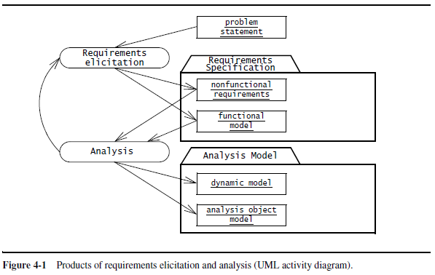

Slide 24
Requirements Elicitation Activities
1. Identifying actors: developers identify the different types of users the future system will support.
2. Identifying scenarios:
developers observe users and develop a set of detailed scenarios (concrete examples of future systems) for typical functionality provided by the future system.
Scenarios used for understanding application domain in detail.

Slide 25
Requirements Elicitation Activities
3. Identifying use cases:
Once developers and users agree on a set of scenarios.
Set of use cases are derived from scenarios that represent future systems.
Use cases are abstractions describing all possible cases of the system

Slide 26
Requirements Elicitation Activities
4. Refining use cases:
requirements specification is complete by detailing each use case.
describing the behavior of the system in the presence of errors and exceptional conditions.

Slide 27
Requirements Elicitation Activities
5. Identifying relationships among use cases:
identify dependencies among use cases.
Consolidate(combine) the use case model by factoring out common functionality.

Slide 28
Requirements Elicitation Activities
Identifying nonfunctional requirements:
developers, users, and clients agree on aspects that are visible to the user, but not directly related to functionality.
These include constraints on the performance of the system, its documentation, the resources it consumes, its security, and its quality.

Slide 29
Requirement Elicitation Techniques
  Questionnaires: Asking the end user a list of pre-selected questions
  Task Analysis: Observing end users in their operational environment
  Scenarios: Describe the use of the system as a series of interactions between a concrete end user and the system
  Use cases: Abstractions that describe a class of scenarios.

Slide 30
Functional Requirements
Functional requirements describe the interactions between the system and its environment independent of its implementation.
Does not focus on implementation details.
Example: SatWatch, a watch that resets itself without user intervention

Slide 31
Non-Functional Requirements
Nonfunctional requirements describe aspects of the system that are not directly related to the functional behavior of the system.
Usability to performance - non functional requirements

Slide 32
Non-Functional Requirements (Types)
1. Usability is the ease with which a user can learn to operate or use system.
Usability requirements: online help or user level documentation , manual etc.
Clients can set usability issues for developer for example – color scheme for GUI

Slide 33
Non-Functional Requirements
2. Reliability is the ability of a system or component to perform its required functions under stated conditions for a specified period of time.
Reliability is replaced with dependability which includes other features like robustness and safety

Slide 34
Non-Functional Requirements (Types)
3. Performance requirements are concerned with quantifiable attributes of the system such as:
Response Time
Throughput
Availability
Accuracy

Slide 35
Non-Functional Requirements (Types)
4. Supportability requirements are concerned with the ease of changes to the system after deployment.
Adaptability: the ability to change the system to deal with additional application domain concepts.
Maintainability: the ability to change the system to deal with new technology or to fix defects.
Internationalization: the ability to change the system to deal with additional international conventions, such as languages, units, and number formats

Slide 36
Additional Non-functional Requirements
Implementation requirements
constraints on the implementation of the system.
specific tools, programming languages, or hardware platforms.
Interface requirements
are constraints imposed by external systems
interchange formats

Slide 37
Additional Non-functional Requirements
Operations requirements
are constraints on the administration and management of the system.
Packaging requirements
are constraints on the actual delivery of the system
Installation media for software setting

Slide 38
Additional Non-functional Requirements
Legal requirements
are concerned with licensing, regulation, and certification issues.
Quality requirements

Slide 39
Requirements Characteristics
Requirements are continuously validated with the client and the user.
Requirement validation involves checking that the specification is complete, consistent, unambiguous, and correct.

Slide 40
Requirements Characteristics
Completeness: It is complete if all possible scenarios through the system are described, including exceptional behavior.
Complete—All features of interest are described by requirements.
Example of incompleteness: Satwatch’s limitation of state boundary.
Solution: addition of the boundary feature.

Slide 41
Requirements Characteristics
2. Consistent: The requirements specification is consistent if it does not contradict itself.
Consistent—No two requirements of the specification contradict each other.
Example of inconsistency: Software fault and upgrading mechanisms for new versions.
Solution: Revise one of the conflicting requirements

Slide 42
Requirements Characteristics
3. Unambiguous — The requirements specification is unambiguous if exactly one system is defined.
A requirement cannot be interpreted in two mutually exclusive (either) ways.
Example of ambiguity: time zones and political boundaries.
Does SatWatch deal with daylight saving time or not?
Solution: add a requirement that SatWatch should deal with daylight saving time.

Slide 43
Requirements Characteristics
4. Correct: represents accurately the system that the client needs and that the developers intend to build.
Correct—The requirements describe the features of the system and environment of interest to the client and the developer, but do not describe other unintended features.

Slide 44
Requirement Specification
Three more desirable properties (qualities) of a requirements specification are that it be realistic, verifiable, and traceable.
Realistic: if the system can be implemented within constraints.
Verifiable: if once the system is built, repeatable tests designed to demonstrate that the system fulfills the requirements specification.

Slide 45
Requirement Specification
Traceability: if each requirement can be traced throughout the software development to its system functions, and vice-versa.
Traceability includes also the ability to track the dependencies among requirements, system functions, and the intermediate designs.

Slide 46

Use Case Diagrams
Identifying Actors
Actors represent external entities that interact with the system.
An actor can be human or an external system.
Actor

Slide 47
Use Case Diagrams
Give meaningful business relevant names for actors.
Primary actors should be to the left side of the diagram –highlight the important roles in the system.
Actors model roles (not positions) – In a hotel both the front office executive and shift manager can make reservations. “Reservation Agent” actor name to highlight the role.
External systems are actors – If your use case is send email and if interacts with the email management software then the software is an actor to that particular use case.
Actors don’t interact with other actors
Place inheriting actors below the parent actor

Slide 48
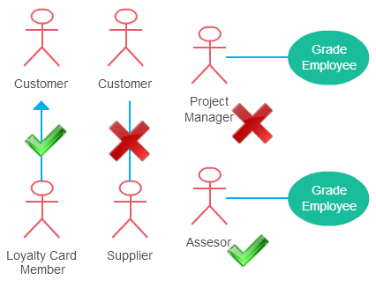

Slide 49
Use Case Diagram
Once the actors are identified, the next step in the requirements elicitation activity is to determine the functionality that will be accessible to each actor.
Use cases are external (user) view of a system
Intended for modeling dialogue between user and system

Slide 50
Use Case Diagram
Identifying Scenarios
A scenario is a narrative description of what people do and experience as they try to make use of computer systems and applications.
Scenario is description of the system from single actor’s or user’s point of view.
Scenarios may be defined for current , future , evaluation or training phases of the software development process.

Slide 51
Use Case Diagram
Identifying Use Cases
Use cases represent what the actors want your system to do for them.
A use case represents a complete flow of events through the system.
A Use Case captures some actor-visible function
- Achieves some discrete (business-level) goal for that actor
- May be read, write, or read-modify-write in nature

Slide 52
Use Case Diagram
Names begin with a verb – An use case models an action so the name should begin with a verb.
Make the name descriptive – This is to give more information for others who are looking at the diagram. For example “Print Invoice” is better than “Print”.
Highlight the logical order – For example if you’re analyzing a bank customer typical use cases include open account, deposit and withdraw. Showing them in the logical order makes more sense.
Place included use cases to the right of the invoking use case – This is done to improve readability and add clarity.
Place inheriting use case below parent use case – Again this is done to improve the readability of the diagram.

Slide 53
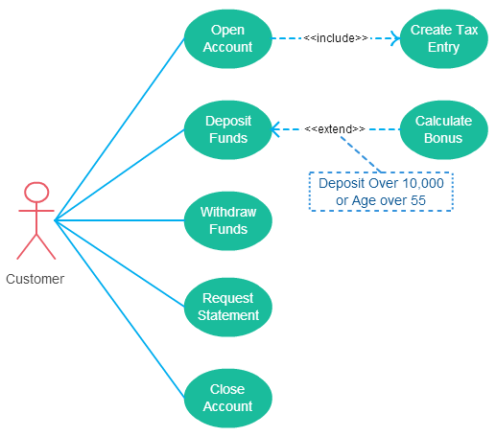

Slide 54
Elements of use case diagram: Actor
Actor

Slide 55
Elements of use case diagram: Use Case
System function (process – automated or manual).
Use Case
Do Something (Operation)

Slide 56
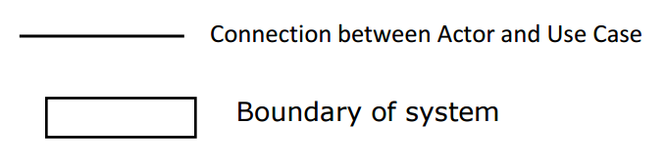
Elements of use case diagram

Slide 57
There can be 5 relationship types in a use case diagram.
Association between actor and use case
Generalization of an actor
Extend between two use cases
Include between two use cases
Generalization of a use case

Slide 58
Association Between Actor and Use Case
This one is straightforward and present in every use case diagram.
An actor must be associated with at least one use case.
An actor can be associated with multiple use cases.
Multiple actors can be associated with a single use case.

Slide 59
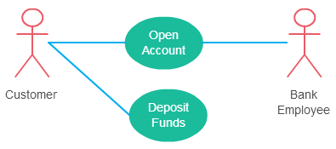
Association Between Actor and Use Case

Slide 60
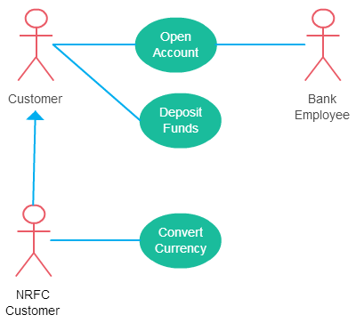
Generalization of an Actor
Generalization of an actor means that one actor can inherit the role of an other actor.

Slide 61
Extend Relationship Between Two Use Cases
It extends the base use case and adds more functionality to the system.
The extending use case is dependent on the extended (base) use case.
The extending use case is usually optional and can be triggered conditionally.
The extended (base) use case must be meaningful on its own.
Arrow points to the base use case when using <<extend>>
Extending use case is optional

Slide 62
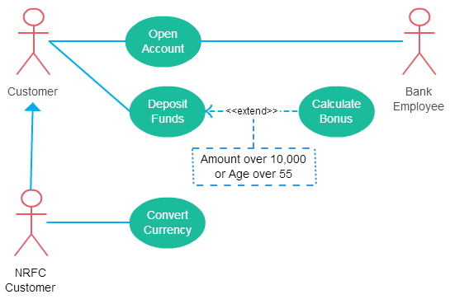

Slide 63
Include Relationship Between Two Use Cases
Include relationship show that the behavior of the included use case is part of the including (base) use case.
The base use case is incomplete without the included use case.
The included use case is mandatory and not optional.
Like a “use case subroutine”

Slide 64
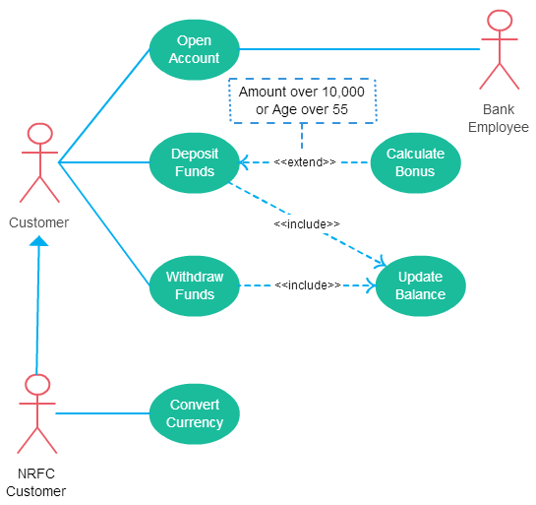

Slide 65
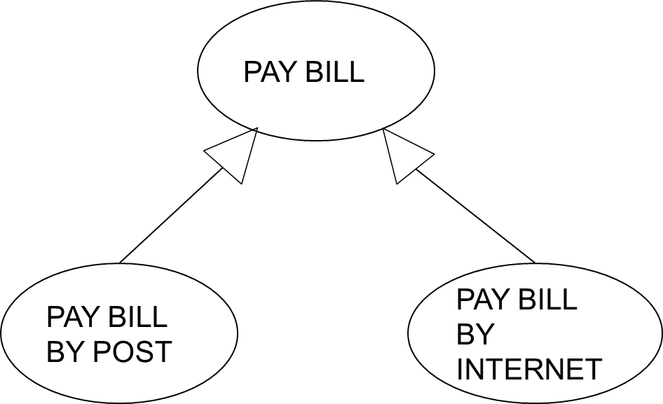
Generalization of a Use Case
This is similar to the generalization of an actor.
This is used when there are common behavior between two use cases and also specialized behavior specific to each use case.

Slide 66
PROBLEM DEFINTION-VENDING MACHINE
A vending machine accepts coins for a variety of products. The user selects the drink from products available through the selection panel. If the drink is available the price of the product is displayed. The user the deposits the coins depending on the price of the product. Coin collector collects the coins. After stipulated time, the controller will compare the deposited coins with the price, If the amount deposited is less than the price then error message will be displayed and all deposited coins will be dispensed by coin dispenser else the drink will be dispensed by the product dispenser. Draw use case diagram.

Slide 67
Use Case Diagram for Vending Machine
Actor- User
Processes involved in the system
  Select product
  Deposit coins
  Verify the deposited amount
  Dispense product
  Dispense coins

Slide 68
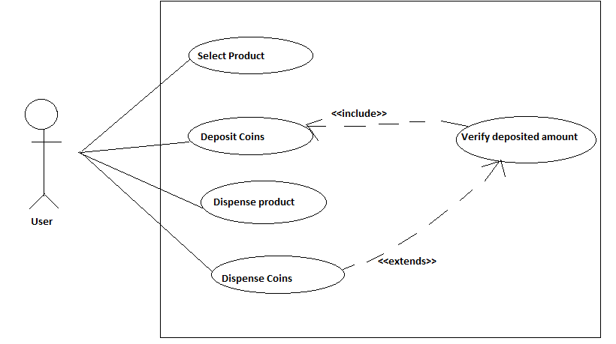

Slide 69
Use Case Example
Customer (actor) uses bank ATM to Check Balances of his/her bank accounts, Deposit Funds, Withdraw Cash and/or Transfer Funds (use cases). ATM Technician provides Maintenance and Repairs. All these use cases also involve Bank actor whether it is related to customer transactions or to the ATM servicing.

Slide 70
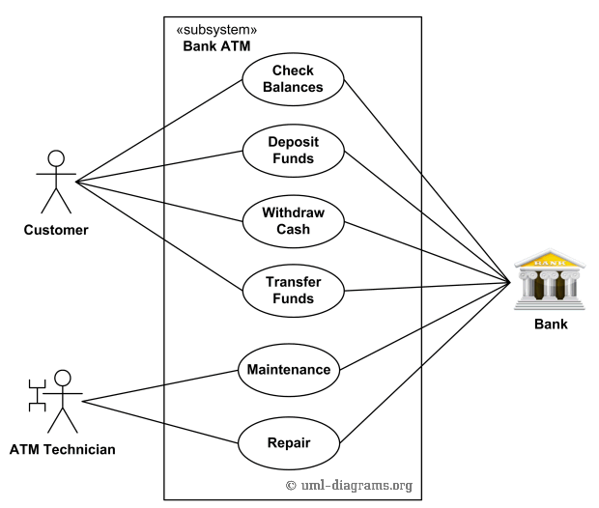

Slide 71
Use Case Example
On most bank ATMs, the customer is authenticated by inserting a plastic ATM card and entering a personal identification number (PIN). Customer Authentication use case is required for every ATM transaction so we show it as include relationship. Including this use case as well as transaction generalizations make the ATM Transaction an abstract use case. Customer may need some help from the ATM. ATM Transaction use case is extended via extension point called menu by the ATM Help use case whenever ATM Transaction is at the location specified by the menu and the bank customer requests help, e.g. by selecting Help menu item.

Slide 72
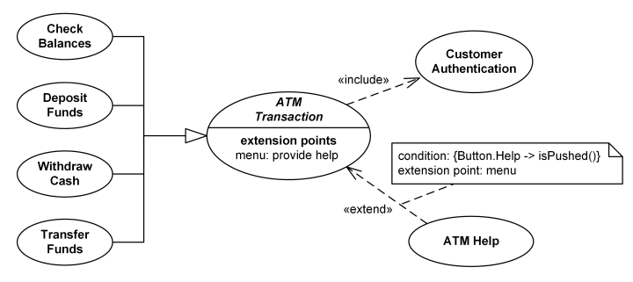

Slide 73
Use Case Example
ATM Technician maintains or repairs Bank ATM. Maintenance use case includes Replenishing ATM with cash, ink or printer paper, Upgrades of hardware, firmware or software, and remote or on-site Diagnostics. Diagnostics is also included in (shared with) Repair use case.

Slide 74
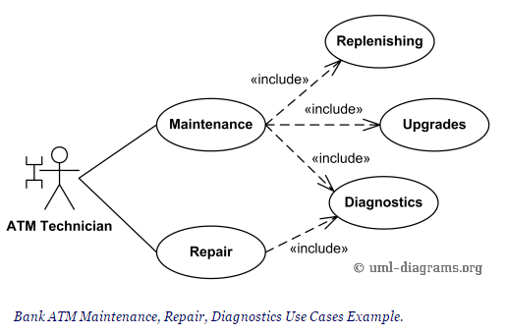

Slide 75
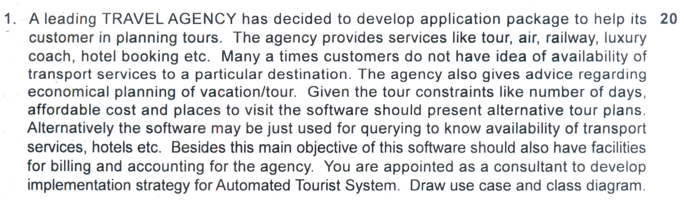

Slide 76
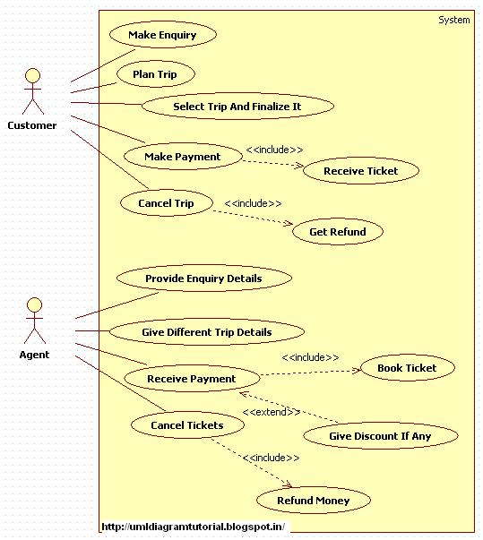

Slide 77
USE CASE
Online Airline Reservation System

Slide 78
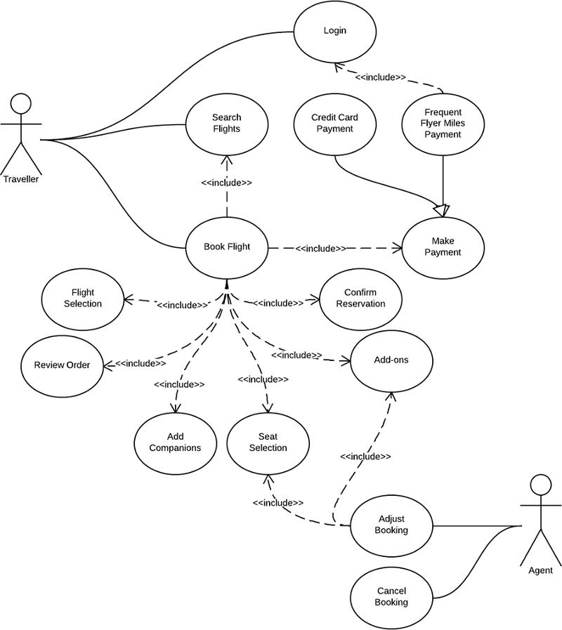

Slide 79
Activity Diagram
An activity diagram describes the behavior of a system in terms of activities.
Activity diagram is basically a flow chart to represent the flow form one activity to another activity.
Activity diagram: operation of a system.
This flow can be sequential, branched or concurrent.

Slide 80

Activity Diagram (basic notations)
Initial node.
The filled in circle is the starting point of the diagram.
It is shown as filled circle.

Slide 81

Activity Diagram (basic notations)
Activity final node.
The filled circle with a border is the ending point.
The final activity is optional.

Slide 82

Activity Diagram (basic notations)
Activity. The rounded rectangles represent activities that occur.

Slide 83
Activity Diagram (basic notations)
Flow/edge (Control Flow)
The arrows on the diagram. Within the control flow an incoming arrow starts a single step of an activity; after the step is completed the flow continues along the outgoing arrow.

Slide 84
Activity Diagram (basic notations)
Decision.
Decisions are branches in the control flow.
They denote alternatives based on a condition of the state of an object or a set of objects.
Decisions are depicted by a diamond with one or more incoming open arrows and two or more outgoing arrows.

Slide 85
Activity Diagram (basic notations)
The outgoing edges are labeled with the conditions that select a branch in the control flow.
Decisions are depicted by a diamond with one or more incoming open arrows and two or more outgoing arrows.
The set of all outgoing edges from a decision represents the set of all possible outcomes.

Slide 86

Activity Diagram (basic notations)

Slide 87
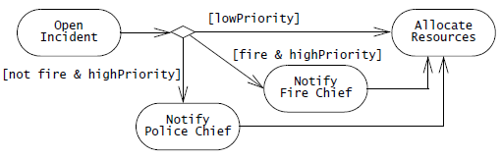

Slide 88
Activity Diagram (basic notations)
Some activities occur simultaneously or in parallel. Such activities are called concurrent activities.
Fork nodes and join nodes represent concurrency.
Fork nodes denote the splitting of the flow of control into multiple threads.
Join nodes denotes the synchronization of multiple threads and their merging of the flow of control into a single thread.

Slide 89
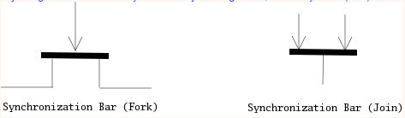

Slide 90
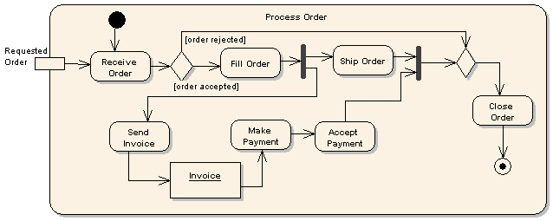

Slide 91
Activity Diagram (basic notations)
Swim Lanes
The contents of an activity diagram may be organized into partitions (swimlanes) using solid vertical lines.
A swim lane (or swimlane diagram) is a visual element used in process flow diagrams, or flowcharts, that visually distinguishes job sharing and responsibilities for sub-processes of a business process.

Slide 92
Activity Diagram (basic notations)
Order Swimlanes in a Logical Manner.
Apply Swim Lanes To Linear Processes.
Have Less Than Five Swimlanes.
Consider Swim areas For Complex Diagrams.

Slide 93
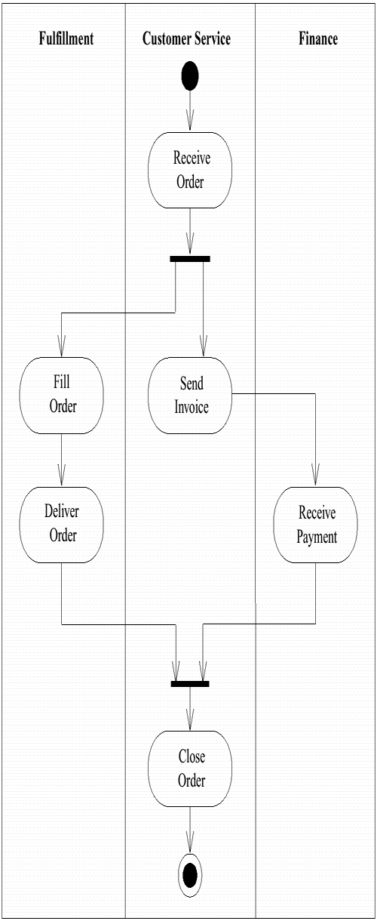

Slide 94
Problem
Activity Diagram for Ticket Vending Machine
Problem Definition: Draw Activity Diagram for Login Procedure of a system.

Slide 95
Problem Definition
Activity is started by Commuter actor who needs to buy a ticket. Ticket vending machine will request trip information from Commuter. This information will include number and type of tickets, e.g. whether it is a monthly pass, one way or round ticket, route number, destination or zone number, etc. Based on the provided trip info ticket vending machine will calculate payment due and request payment options. Those options include payment by cash, or by credit or debit card. If payment by card was selected by Commuter, another actor, Bank will participate in the activity by authorizing the payment. After payment is complete, ticket is dispensed to the Commuter. Cash payment might result in some change due, so the change is dispensed to the Commuter in this case. Ticket vending machine will show some "Thank You" screen at the end of the activity.

Slide 96
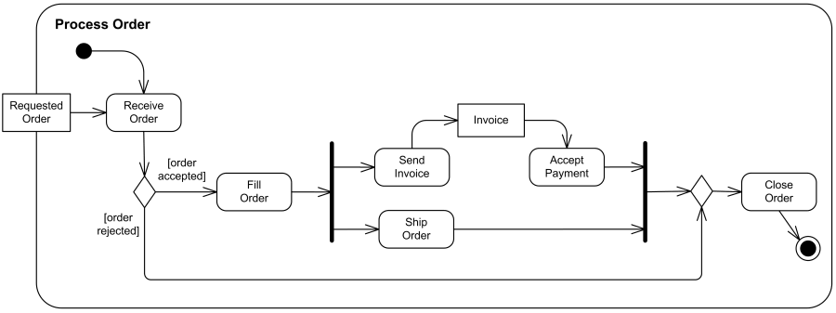
An example of business flow activity to process purchase order.

Slide 97
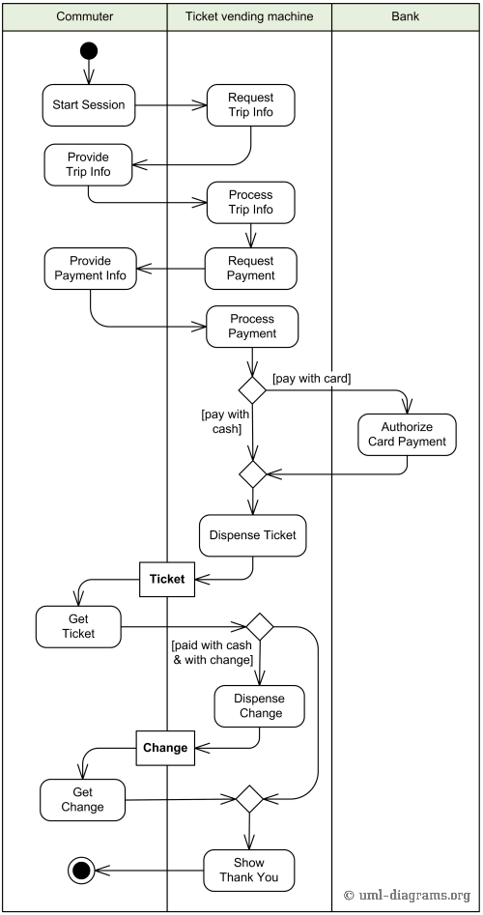

Slide 98
Class Diagram
A Class Diagram is a diagram describing the structure of a system.
shows the system's
classes
Attributes
operations (or methods),
Relationships among the classes.

Slide 99
Essential Elements of a
Class Diagram
Class: A class represents the blueprint of its objects.
Attributes
Operations
Relationships
Associations
Generalization
Realization
Dependency

Slide 100
Class
Describes a set of objects having similar:
  Attributes (status)
  Operations (behavior)
  Relationships with other classes
Attributes and operations may
  have their visibility marked:
  "+" for public
  "#" for protected
  "−" for private
  "~" for package
Class Name
Window
size: Size
visibility: boolean
Attributes
display()
hide()
Operations

Slide 101
Associations
An association between two classes indicates that objects at one end of an association “recognize” objects at the other end and may send messages to them.
Example: “An Employee works for a Company”
Employee
Company

Slide 102
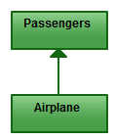
Directed Association
Refers to a directional relationship represented by a line with an arrowhead. The arrowhead depicts a container-contained directional flow.

Slide 103
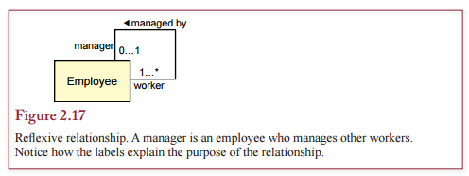
Reflexive Association
A reflexive association is a relationship from one class back to itself.

Slide 104
Role name
Association name
instructor
Student
StaffMember
1..*
instructs
*
Role
Navigable
(uni-directional) association
Multiplicity
*
Courses

Slide 105
Association Class
In modeling an association, there are times when you need to include another class because it includes valuable information about the relationship.
use an association class that you tie to the primary association.
An association class is represented like a normal class.
The difference is that the association line between the primary classes intersects a dotted line connected to the association class.

Slide 106
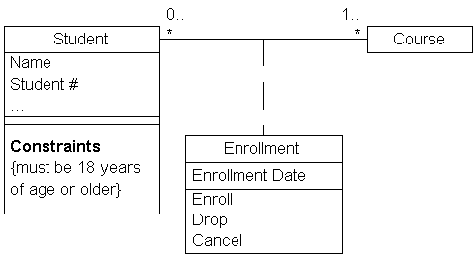

Slide 107
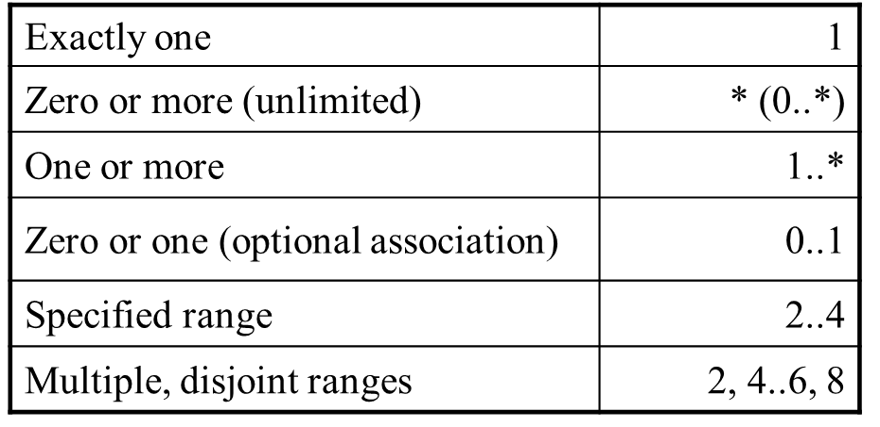
Multiplicity
  the number of objects that participate in the association.
  Multiplicity Indicators

Slide 108

Basic Aggregation
Aggregation is a special type of association used to model a "whole to its parts" relationship.
Example: Car as a whole entity and Car Wheel as part of the overall Car.

Slide 109
2..*
Door
1..*
Car
House
Whole
Part

Slide 110
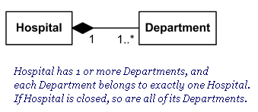
Composition Aggregation
A strong form of aggregation
  The whole is the sole owner of its part.
    The part object may belong to only one whole
  Multiplicity on the whole side must be zero or one.
  The life time of the part is dependent upon the whole.

Slide 111
Generalization
The Generalization association ("is a") is the relationship between the base class that is named as “superclass” or “parent” and the specific class that is named as “subclass” or “child”.

Slide 112
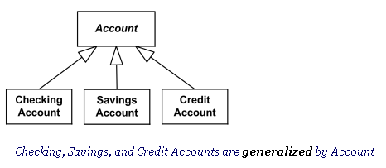
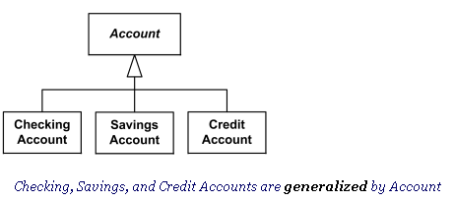

Slide 113
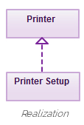
Realization
A realization relationship indicates that one class implements a behavior specified by another class (an interface or protocol).
a broken line with an unfilled solid arrowhead is drawn from the class that defines the functionality to the class that implements the function.

Slide 114

Dependency
It means that the class at the source end of the relationship has some sort of dependency on the class at the target (arrowhead) end of the relationship.

Slide 115
Dependency
In UML, a dependency relationship is a relationship in which one element, the client, uses or depends on another element, the supplier.
a Cart class depends on a Product class because the Cart class uses the Product class as a parameter for an add operation.
Cart class is, therefore, the client, and the Product class is the supplier.

Slide 116

Dependency shows that an element is dependent on another element as it fulfils its responsibilities within the system

Slide 117
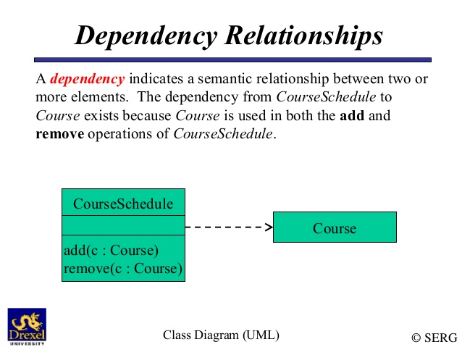

Slide 118
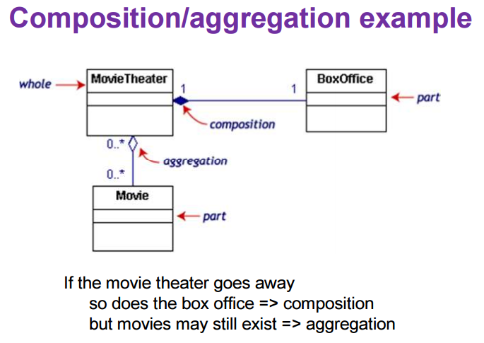

Slide 119
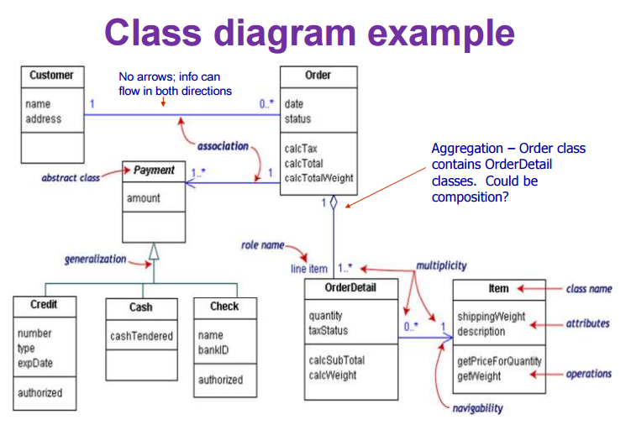

Slide 120
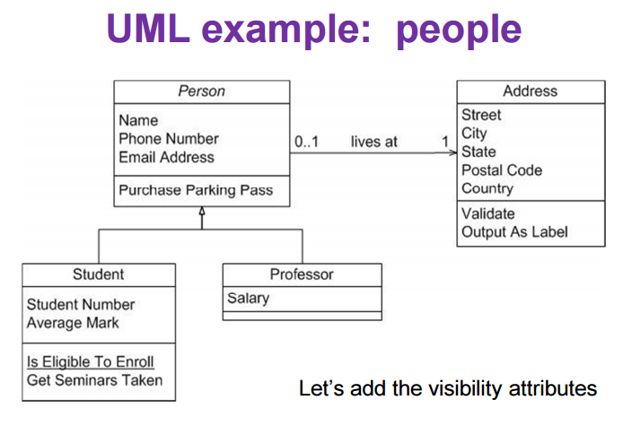

Slide 121
Sequence Diagram
The Sequence Diagram models the collaboration of objects based on a time sequence.
Sequence diagrams represent the objects participating in the interaction horizontally and time vertically.

Slide 122
Sequence Diagrams
Depicts sequence of actions that occur in a system
Useful tool to represent dynamic behavior of a system
2 dimensional :
  Horizontal axis
  Vertical axis

Slide 123
Sequence Diagram
The focus is less on messages themselves and more on the order in which messages.
Sequence diagrams are good at showing which objects communicate with which other objects; and what messages trigger those communications.

Slide 124
Participants in a Sequence Diagram
A sequence diagram is made up of a collection of participants.
Participants – the system parts that interact each other during the sequence.
• Classes or Objects – each class (object) in the interaction is represented by its named icon along the top of the diagram

Slide 125
Elements of Sequence Diagram
ACTOR
OBJECTS
LIFELINES
MESSAGES
ACTIVATION-represents time an object needs to complete task

Slide 126

Elements of Sequence Diagram
Class Roles or Participants or Objects: Class roles describe the way an object will behave in context.

Slide 127
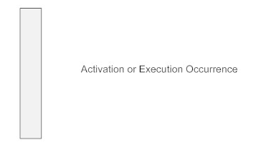
Elements of Sequence Diagram
Activation or Execution Occurrence
Activation boxes represent the time an object needs to complete a task.
When an object is busy executing a process or waiting for a reply message, use a thin gray rectangle placed vertically on its lifeline.

Slide 128

Elements of Sequence Diagram
Synchronous Message
A synchronous message requires a response before the interaction can continue.
It's usually drawn using a line with a solid arrowhead pointing from one object to another.

Slide 129

Elements of Sequence Diagram
Asynchronous Message
Asynchronous messages don't need a reply for interaction to continue.
They are drawn with an arrow connecting two lifelines; however, the arrowhead is usually open and there's no return message depicted.

Slide 130

Elements of Sequence Diagram
Reply or Return Message
A reply message is drawn with a dotted line and an open arrowhead pointing back to the original lifeline.

Slide 131
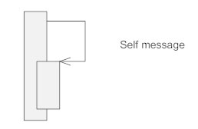
Elements of Sequence Diagram
Self Message
A message an object sends to itself, usually shown as a U shaped arrow pointing back to itself.

Slide 132
Elements of Sequence Diagram
Lost: A lost message occurs whet the sender of the message is known but there is no reception of the message.
Found: A found message indicates that although the receiver of the message is known in the current interaction fragment, the sender of the message is unknown.

Slide 133
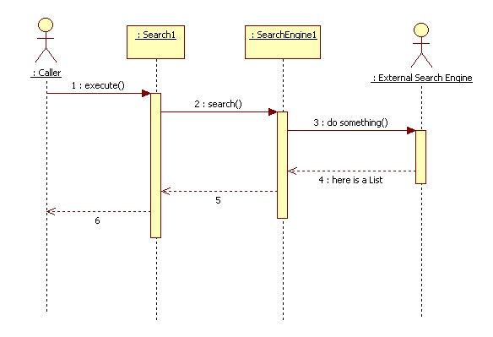

Slide 134
Sequence diagrams: an example
Actor
Instances of classes

Slide 135
Sequence Diagram: Lifelines
:object1
:object2
:object3
:actor
Time
Each object has a lifeline.
Time flows from top to down.

Slide 136
Sequence diagrams: rectangles
:object1
:object2
:object3
:actor
Time
Rectangles refer to events that are related to each other.

Slide 137
Sequence diagrams: messages
:object1
:object2
:object3
:actor
Time
Arrows indicate messages that are sent from one object to another.

Slide 138
Sequence diagrams - different types of messages
Message
An object sends a message to itself.
Feedback arrow shows that a value is returned.

Slide 139
Sequence diagrams: endpoints
X at the end of the lifeline shows that the object ceases to exist.

Slide 140
Sequence Diagram
Draw sequence diagram for login procedure of a system. Include all possible scenarios and also draw activity diagram. (10M)

Slide 141
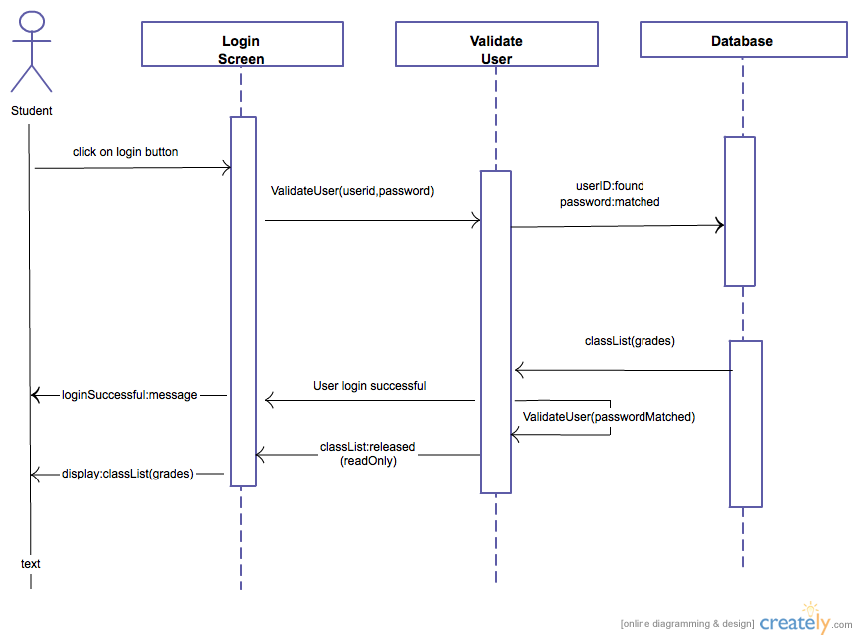

Slide 142
Collaboration Diagram
Collaboration diagram-emphasis is on structural organization of the objects that send/receive messages.
Object
Relation/Association
Messages
Elements of a collaboration diagram
Object Name: Class Name
Object Name: Class Name
Function()

Slide 143
STEPS TO DRAW COLLABORATION DIAGRAM
Place objects as vertices in a graph
Add links to connect these object as arcs of graph
Write messages on links with sequence numbers for send and receive

Slide 144
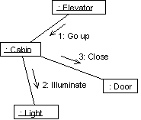
Ex. Collaboration Diagram

Slide 145
Collaboration Diagram Syntax
AN ACTOR
AN OBJECT
AN ASSOCIATION
A MESSAGE
anObject:aClass
aMessage()

Slide 146
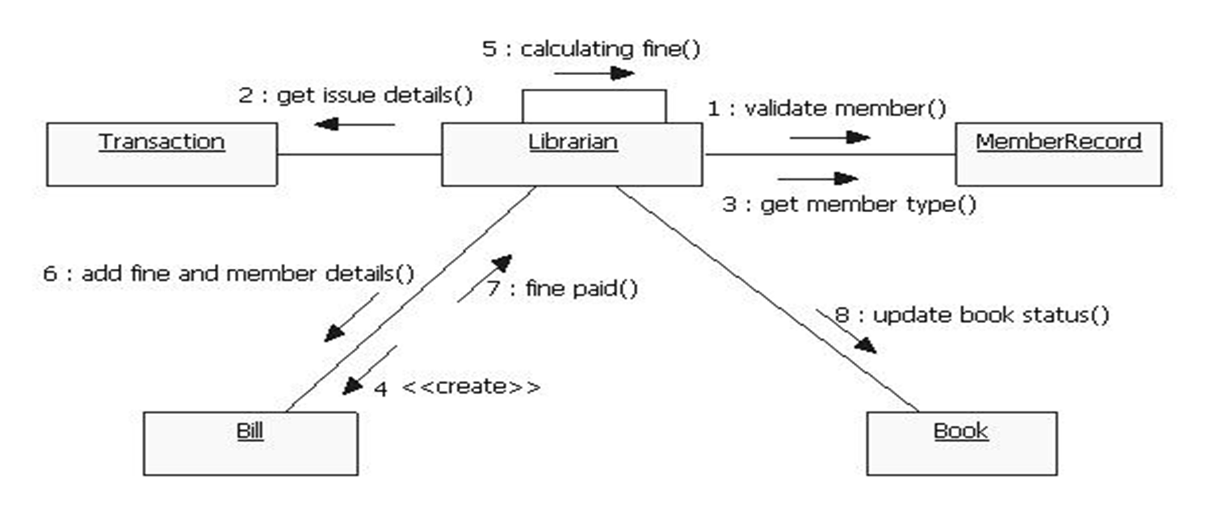

Slide 147
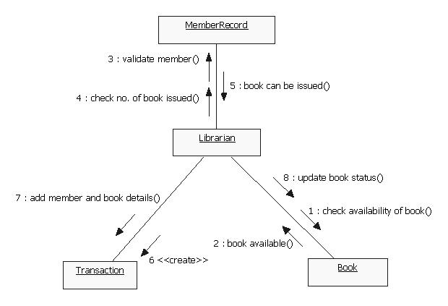

Slide 148
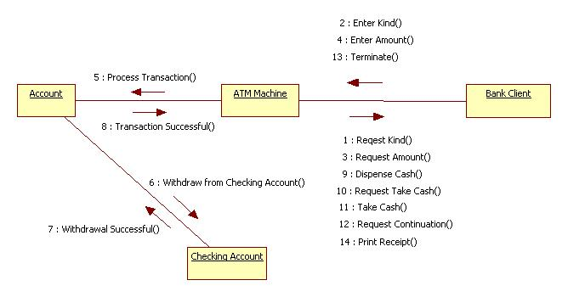

Slide 149
State Chart Diagram
A state in UML is a condition or situation an object (in a system) might find itself in during its life time.
A state chart diagram is normally used to model how the state of an object changes in its lifetime.
We capture the behavior of the subject object through modeling these various states and transitions between them.

Slide 150
State Chart Diagram
Thus, a state machine diagram does not necessarily model all possible states, but rather the critical ones only. When we say “critical” states, we mean those that act as stimuli and prompt for response in the external world.

Slide 151
State Chart Diagram
Initial state. This is represented as a filled circle.
• Final state. This is represented by a filled circle inside a larger circle.
• State. These are represented by rectangles with rounded corners.
• Transition. A transition is shown as an arrow between two states. Normally, the name of the event which causes the transition is places along side the arrow.

Slide 152

State Chart Diagram
A guard condition is a condition that has to be met in order to enable the transition to which it belongs:
Guard conditions can be used to document that a certain event, depending on the condition, can lead to different transitions.

Slide 153

Elements of state diagram
Initial State
State
Transition
Final States
Event[Guard Condition]/Action]

Slide 154
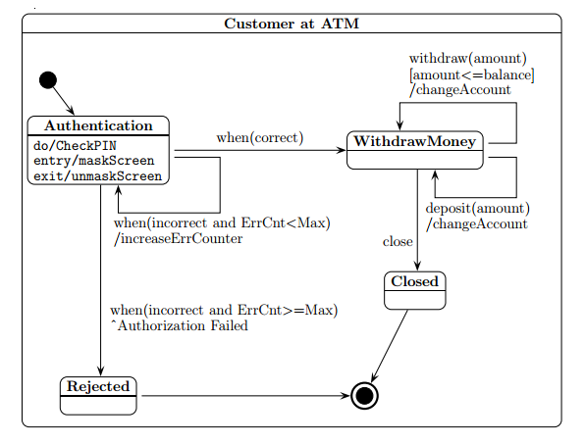
ATM Withdraw

Slide 155
